Slide 1
Python Web Development
9/8/18

Slide 2
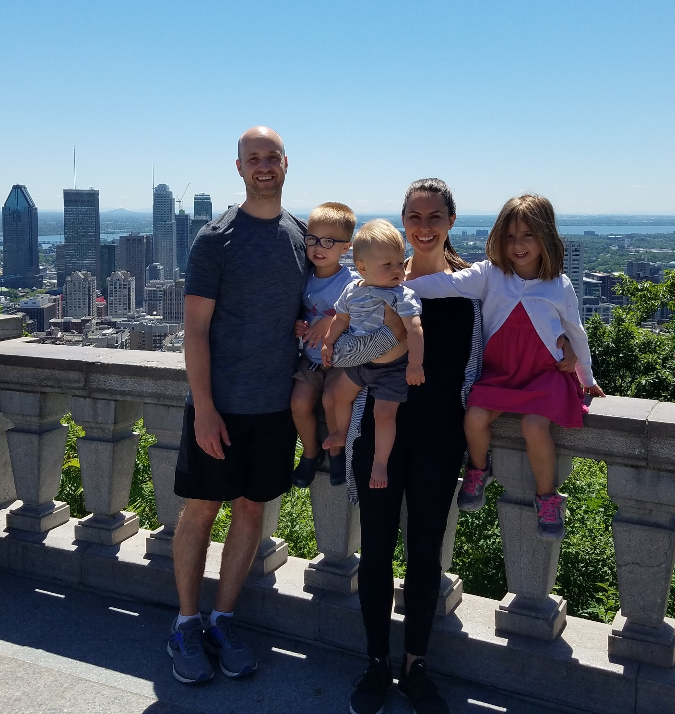
About Me
Sam Waters
DAPT class of 2016
Chief Technology Officer at DSD Partners, Inc
Data Nerd

Slide 3
The Web…For Data Science?
Why? Just why?
Thinking through the details
Leadership
Empathy
Prototyping
Communication
Presentation skills
Storytelling
Data visualization
Business insight
Writing / publishing skills

Slide 4





Web Frameworks
What is a web framework?
A software framework that is designed to support the development of web applications including web services, web resources, and web APIs.
Web frameworks aim to automate the overhead associated with common activities performed in web development.
Some Popular Web Frameworks

Slide 5

Why Flask?
Easy to learn
Simple
Unopinionated
Lightweight

Slide 6
Flask – Rules, Structure, etc
Rules:
Directory structure matters
Allows you to use helpers to find files easily
Flask is pretty bare bones
Be careful about security!
There is a large community
Don’t reinvent the wheel…unless you have to.
Structure:
Models: Object Oriented DB structure (we will not use this today).
Views: Python code doing the heavy lifting
Templates: HTML, JS scripts, Inline CSS for front-end
Jinja2 & WTForms
Static Files: CSS files, JS files, images, etc

Slide 7
Flask - Community
Flask has a large community
Many packages to make life easier
Flask-Login
Flask-Security
Flask-Socketio
…and plenty more
Keep in mind, the Python community loves Object Relational Mappers (ORMs). A lot of these packages/libraries require them.
Spoiler Alert: I’m not a fan!

Slide 8
Let’s get our hands dirty
Things to remember:
I’ve built a few websites and I really like Flask…but I’m not a web developer
I really do not enjoy writing complex HTML and CSS. You won’t see that here
I expect that you have a working knowledge of Python
While not exactly required, I expect you understand basic ML concepts and have familiarity with SKLearn
Are there better ways to do some of this? Yes. However, my goal is to introduce, not train on best practices.

Slide 9
Key Terms
Forms: HTML elements that allow you to submit/retrieve user input
HTML: Hypertext Markup Language – the ugly building blocks of the web.
CSS: Cascading Style Sheets – the way to make HTML look pretty
JavaScript: The language of the web. Allows for advanced interactivity in the browser.
D3.js: JavaScript library for data visualization
Route: building block of a URL.

Slide 10
Jinja2 - Routes
@app.route(‘/site’, methods = [‘GET’, ‘POST’])
def myFunc():
#Do stuff
myVar = ‘Hello There’
return render_template(‘asdf.html’, myVar = myVar)

Slide 11
Jinja2 - Variables
<h1>Hello {{ myVar }}!</h1>
<div class = ‘whatever’>
{{ myVar }}
</div>

Slide 12
Jinja2 – Loops, Conditionals
{% if messageHistory %}
{% for name, message, dt in messageHistory %}
{% if name == theirName %}
<div class = 'w3-row w3-container w3-mobile'>
<div class = 'w3-col w3-container w3-mobile container darker' style = 'width:50%;'><b style="color: #000">{{ name }} </b>{{ message }}
<br>{{ dt }}
</div>
</div>
{% else %}
<div class = 'w3-row w3-container w3-mobile'>
<div class = 'w3-col w3-container w3-mobile container' style = 'width:50%;'><b style="color: #000">{{ name }} </b>{{ message }}
<br>{{ dt }}
</div>
</div>
{% endif %}
{% endfor %}
{% else %}
<h3 style='color: #ccc;font-size: 30px;'>No message yet..</h3>
{% endif %}

Slide 13
Jinja2 - Templates
{% extends 'base.html' %}
{% block content %}
<H1>Choose Customer<H1>
<form action = '/results' method = 'post'>
{{ form.natCustId }}
<p></p>
<button type = 'submit' value = 'Submit' id = 'asubmit'>Submit</button>
</form>
<p>
</p>
<h1>OR</h1>
<a href = '/modelinput'>ML Example</a>
{% endblock %}
Templates are your HTML files
HOWEVER, it’s NOT smart to build each template from scratch
Jinja2 provides EASY template inheritance.
<!DOCTYPE html>
<html>
<title>Analytics Site</title>
<meta name="viewport" content="width=device-width, initial-scale=1">
<link rel="stylesheet" href="https://www.w3schools.com/w3css/4/w3.css">
<body>
<div class = 'w3-red' align = 'center'>
<h1>My Awesome Site</h1>
</div>
{% block content %}
{% endblock %}
</body>
</html>

Slide 14
What are we building?
A simple website that:
Allows you to view a time series graph of Customer Service tickets for the customer of your choice
Allows you to choose a Test Size and Kernel for a Support Vector Classifier on the Iris dataset. The output is an MPL visualization.
Shall we get started?

